Slide 1
Software Testing
Lecture #5

Slide 2
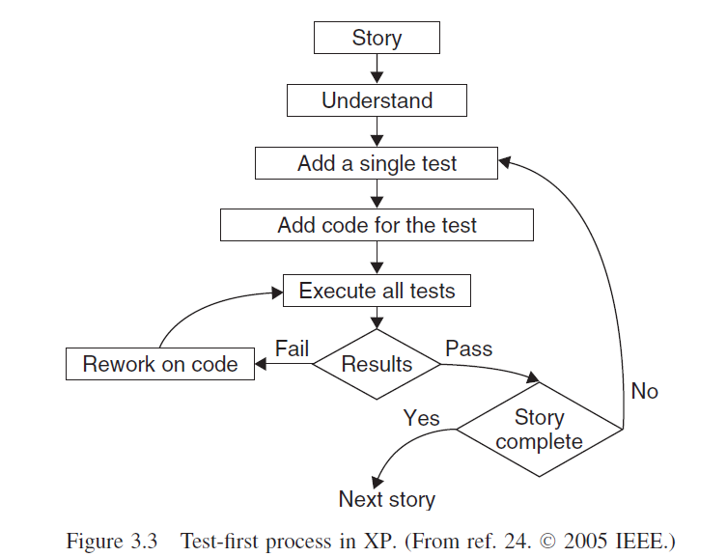
Test First Process in XP

Slide 3
Simple Java Unit Testing with JUnit and Netbeans

Slide 4
What is Unit Testing
Method of testing that verifies the individual units of the code is working properly (Wikipedia).
Test the smallest unit in source code

Slide 5
Why Unit Testing
Verifies if the unit is working offcourse! ☺
Make sure the unit is working even after late changes in source code (regression test)
Provides living documentation of how the units (e.g Method) works.

Slide 6
Unit Testing in Java
2 most used testing framework in java
Junit
TestNG
This time we used Junit because its embedded in netbeans .

Slide 7
What is Junit
Is a unit test framework in java
Developed by Kent Beck and Erich Gamma
Widely used and commonly become standard unit test framework
Is part of xUnit family. xUnit is a ported Junit for various language.
PHPunit (PHP)
Nunit(.NET)

Slide 8
Simple JUnit
Create test class and test case.
Use an assert method for ensuring method output
assertEquals()
assertTrue()
assertNotNull()
Can be invoked manually by running the test class or automated by using ant script

Slide 9
Junit in Netbeans
You don’t need to load the jar into netbeans project.
By default the jar is embedded in test libarary folder
And also netbeans has test class and test case code generation menu

Slide 10
Lets Do The Code
Lets start with heating up our Netbeans 8.2 and create new java project.
Make a simple class having both return valued and void method.
Let the return valued method do simple process for example addition or substraction.
Just print something in the void method.

Slide 11
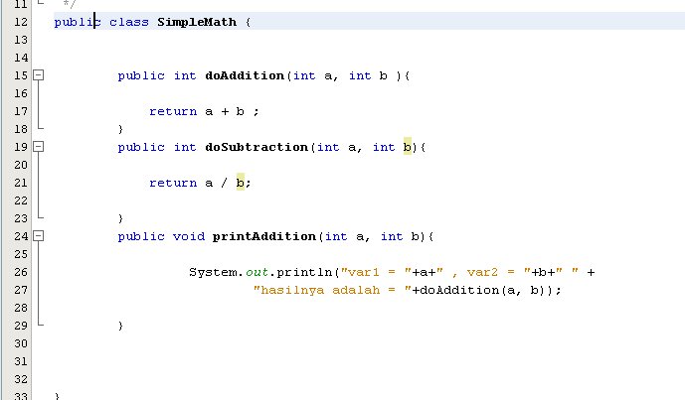
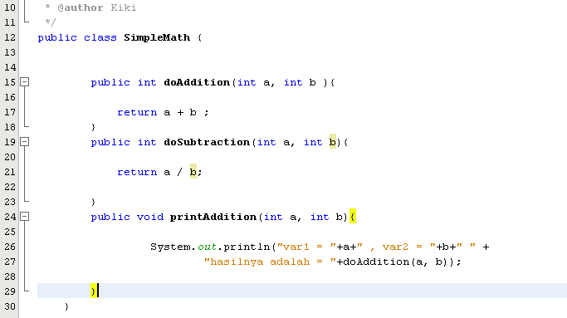
SimpleMath.java

Slide 12
Create Unit Test

Slide 13
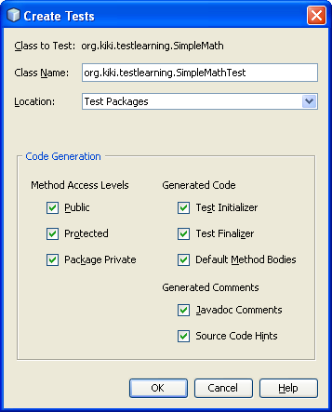
Unit Test Window

Slide 14
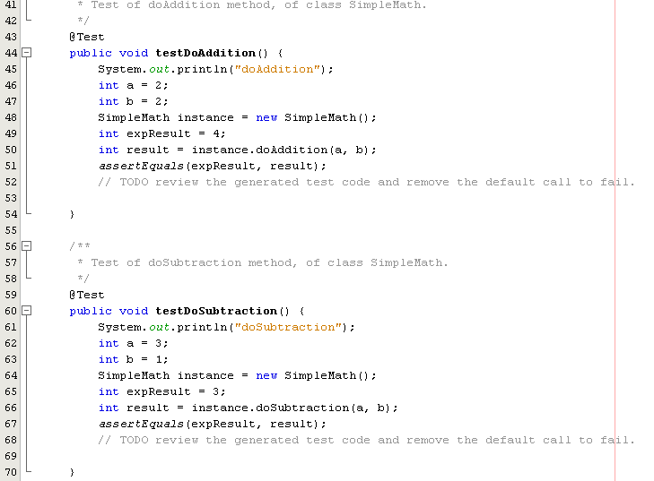
SimpleMathTest.java

Slide 15
Unit Testing
Assign the variable value for the test case.
Remove the fail() method in return valued method test.
Run the test class using Shift + F6.
See the test result

Slide 16
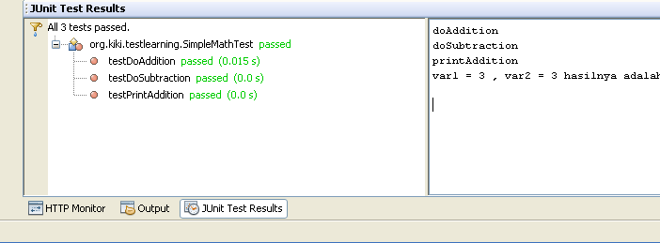
Test Result

Slide 17
Debugging
The programmer, after a program failure, identifies the corresponding fault and fixes it. The process of determining the cause of a failure is known as debugging.

Slide 18
Brute Force
“let the computer find the error”
Print statements are scattered throughout the source code.
A dynamic debugger
Instrumentation code[intermediate values]
Memory Dump

Slide 19
Cause Elimination

Slide 20
Back Tracking

